Slide 1
DSA8023: Analytics in Action
Analython 1 Project:
Suspected EV Customers Challenge from Energia
Varun Suresh Kumar
Student ID: 40364111 vsureshkumar01@qub.ac.uk

Slide 2
Introduction:
Based on market research, Ireland (ROI) has 70,000 Electric Vehicle(EV) Customers who own an EV; out of which Energia has 10% of the market share. Around 2.4K EV Customers are identified from Energia database as they are part of the EV Tariff. This analysis is targeted towards identifying the remaining share of EV Customers using the bi-monthly electrical billing data from January 2021 to January 2023.
This dataset consists of information on their account IDs, customers start date, their EV contract start and end dates, their title, EV contract type(New or Old), age band, channel through which they signed up and Geo-financial classification.
The following report will consist of Exploratory Data Analysis of the dataset, steps involved in cleaning / classification of the data, the analysis of the data against Logistic Regression model (3 variants), Decision Tree algorithm modal and finally the recommendations and conclusions inferred from the analysis. This analysis is performed in Python language with sklearn, seaborn, imblearn, scipy libraries.

Slide 3
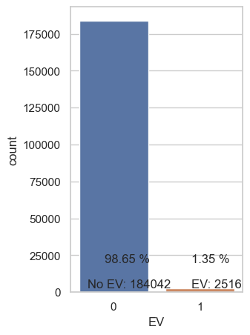
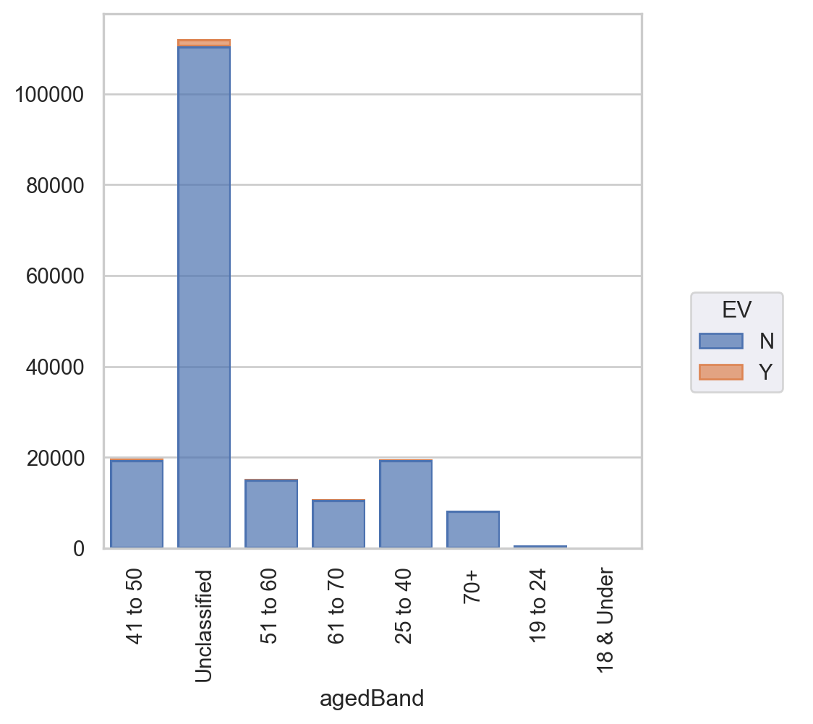
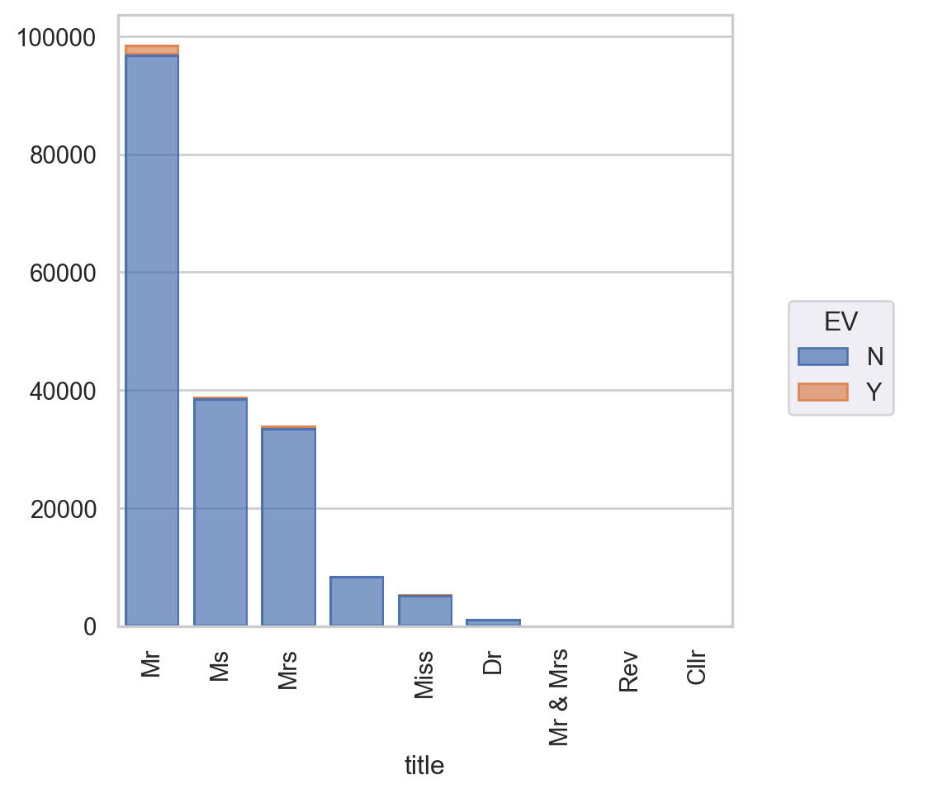
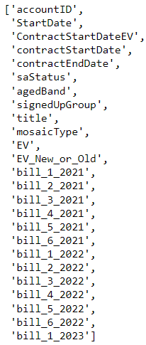
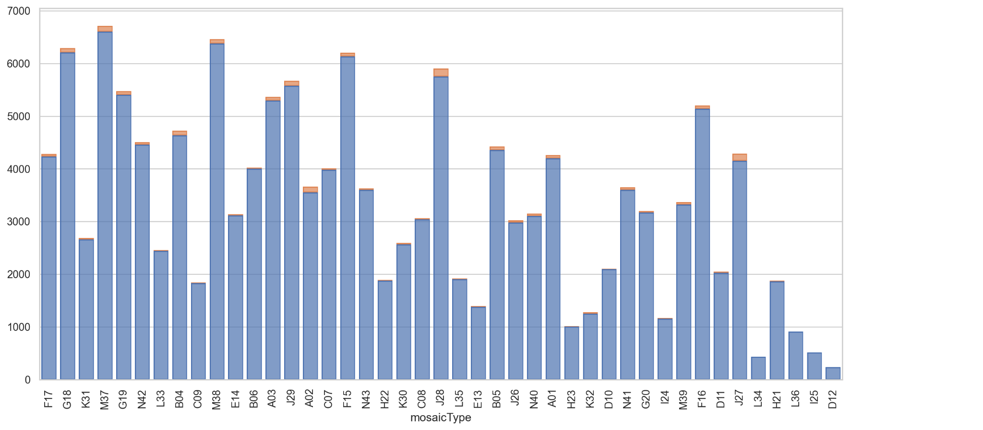
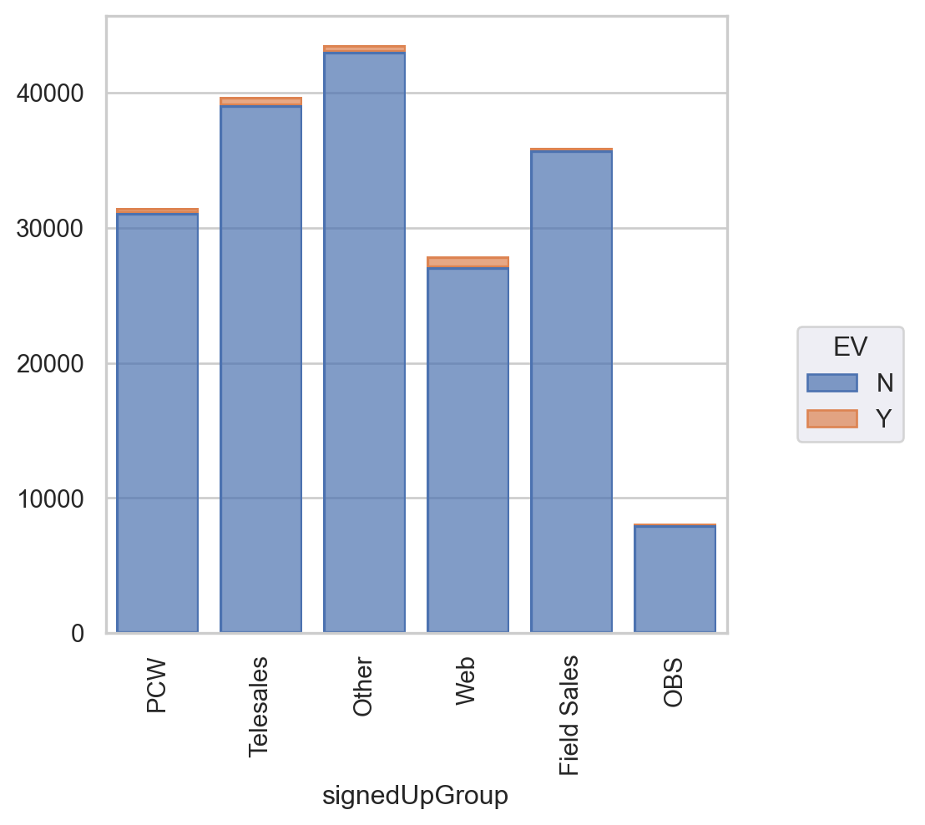
Nature of dataset: Imbalanced

Slide 4
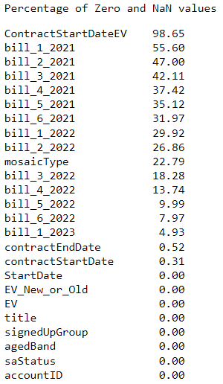
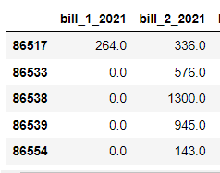
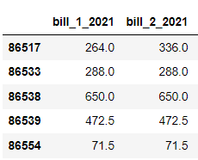

Data Cleaning strategy:
Fact: If reading for a billing cycle is missed, the reading will be included in the next billing cycle. So average reading value is applied for previous and current month. Only one intermittent zero value is filled this way Consecutive zero values are ignored.
Raw Data
Missing value handled

Slide 5
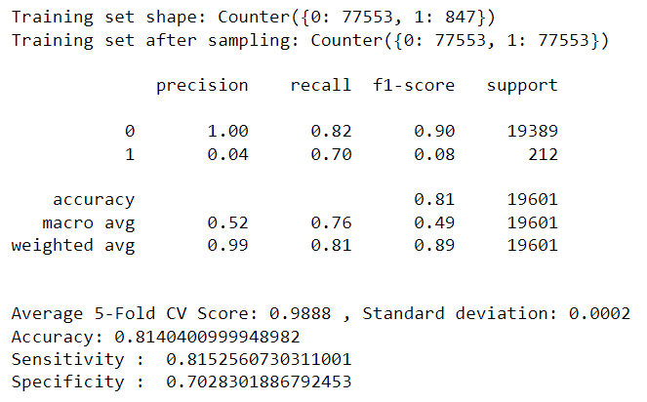
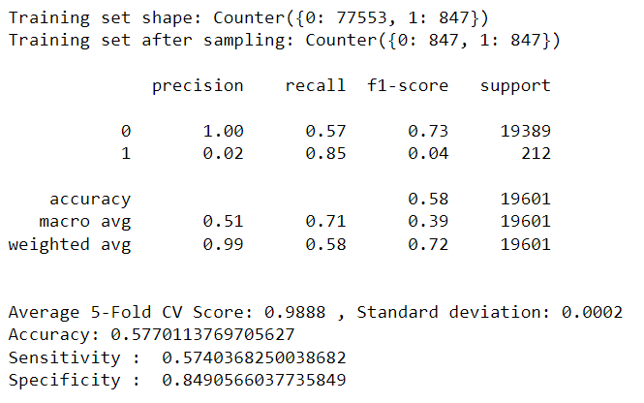
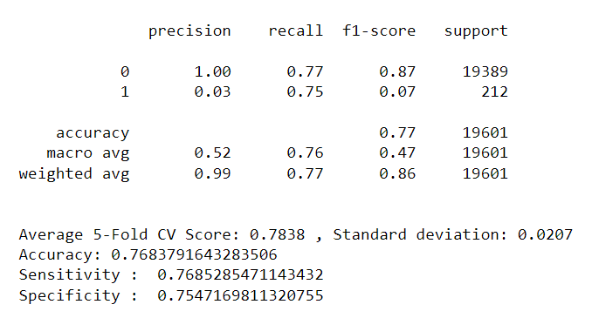
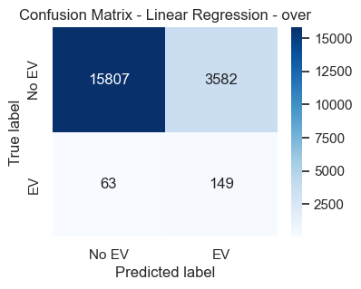
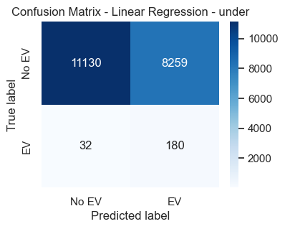
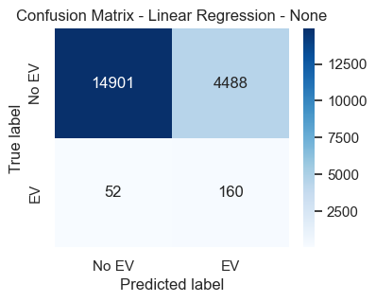
Logistic Regression
Downsampled Upsampled Weighted

Slide 6
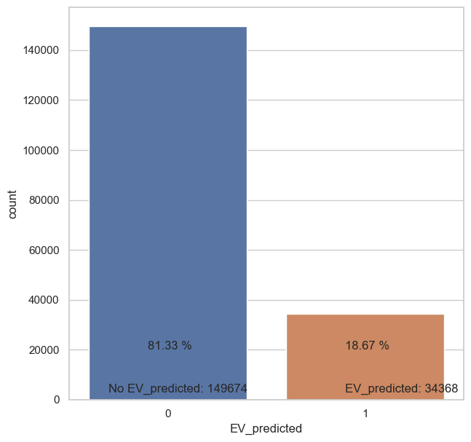
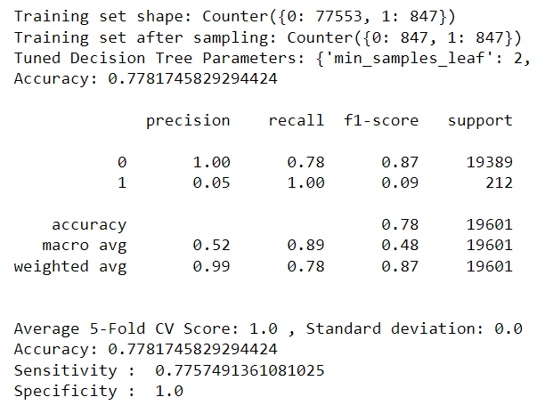
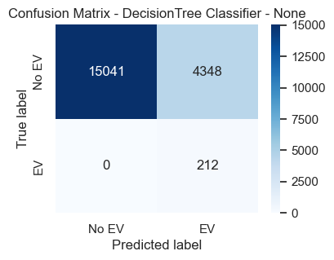
Hyper Tuned Decision Tree Algorithm
Obtained Tuned Decision Tree Parameters:
{'min_samples_leaf': 2, 'max_features': 9, 'max_depth': 7, 'criterion': 'gini'}

Slide 7
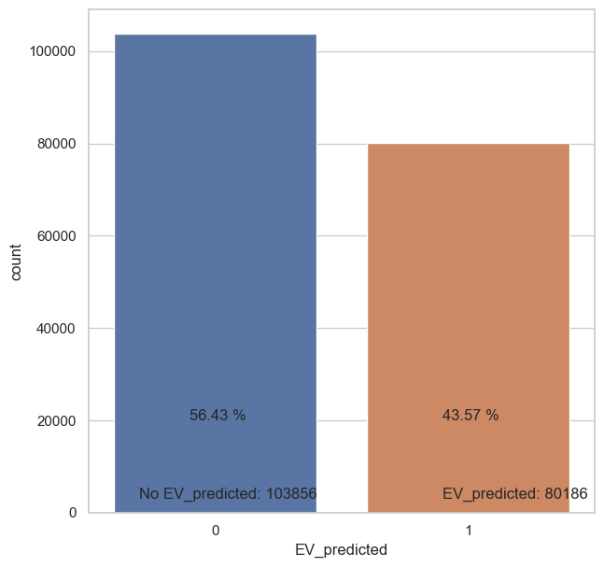
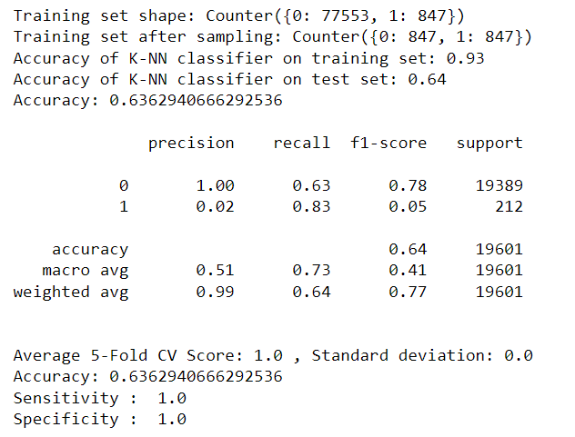
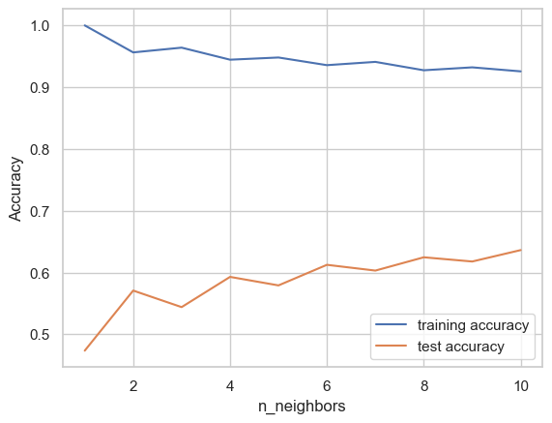
KNN Classifier
To choosing an effective k value in KNN classifier the training and test accuracy are plotted from 1 to 10.
From the plot we find 10 as n_neighbors we get maximum test accuracy.
n_neighbors = 10

Slide 8
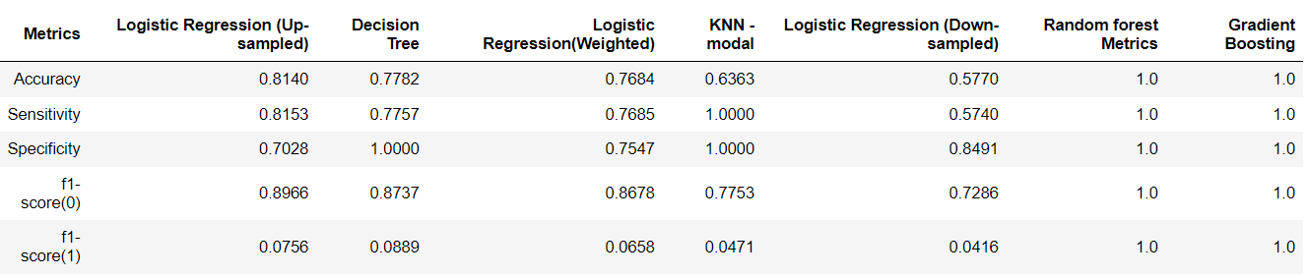
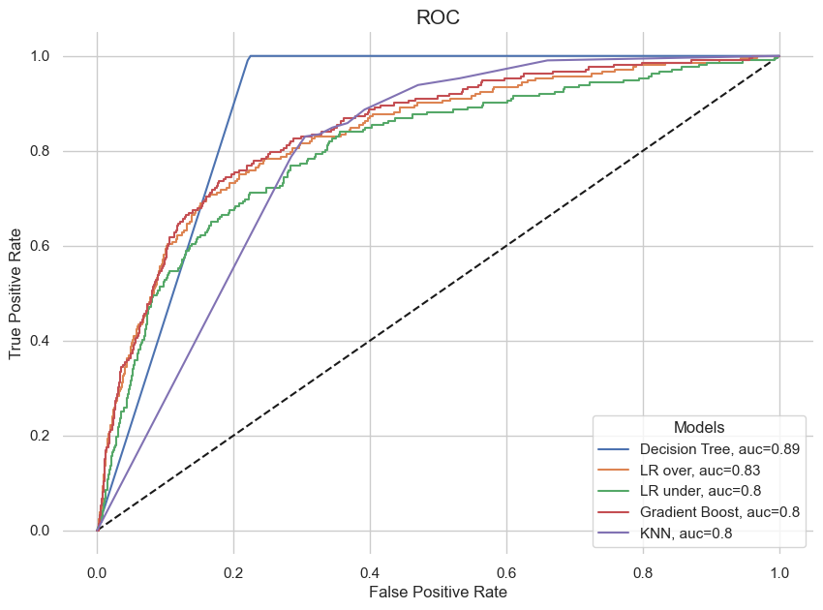
Summary
From the above table we conclude that Logistic Regression modal trained with Oversampled observations produce relatively better accuracy than other modals. Considering f1-score of these modals Decision Tree performs well in identifying (class 1) EV Customers.
No of customers identified from Non EV class:
Decision Tree Algorithm - 34,368(18.67%)
LR Upsampled Algorithm - 48,480(25.99%)

